Slide 1





BUAN 6390.S01 S25 – ANALYTICS PRACTICUM
GROUP 6 - HEALTHCARE COSTS: STOP GUESSING, START SAVING
PROJECT SPONSOR:
VIJAY KONERU
PROFESSOR:
MANDAR SAMANT

Slide 2

MILESTONE 2 HIGHLIGHTS:
FROM COLLECTION TO CLEAN INSIGHTS
Data Collection: Collected data from 8 cities using 10 CSV and 10 JSON files.
Architecture Implementation: Followed the Medallion Architecture:
Bronze Layer: Stored raw ingested data
Silver Layer: Cleaned and structured the data
Gold Layer: Aggregated and enriched data for analysis
Data Preparation: Performed cleaning, transformation, and aggregation.
Output: Validated that our superset is ready for visualization.

Slide 3
MILESTONE 3: ADVANCING FROM STRUCTURE TO SOLUTION
Orchestrated data pipeline with Apache Airflow
Built DAGs for ingestion, cleaning, enrichment, and aggregation
Developed dashboards to compare healthcare costs
Finalized documentation and deliverables

Slide 4



FROM DATA TO STORY: DASHBOARD DEMONSTRATION

Slide 5


SEE IT IN ACTION:
OUR PROJECT IN MOTION

Slide 6
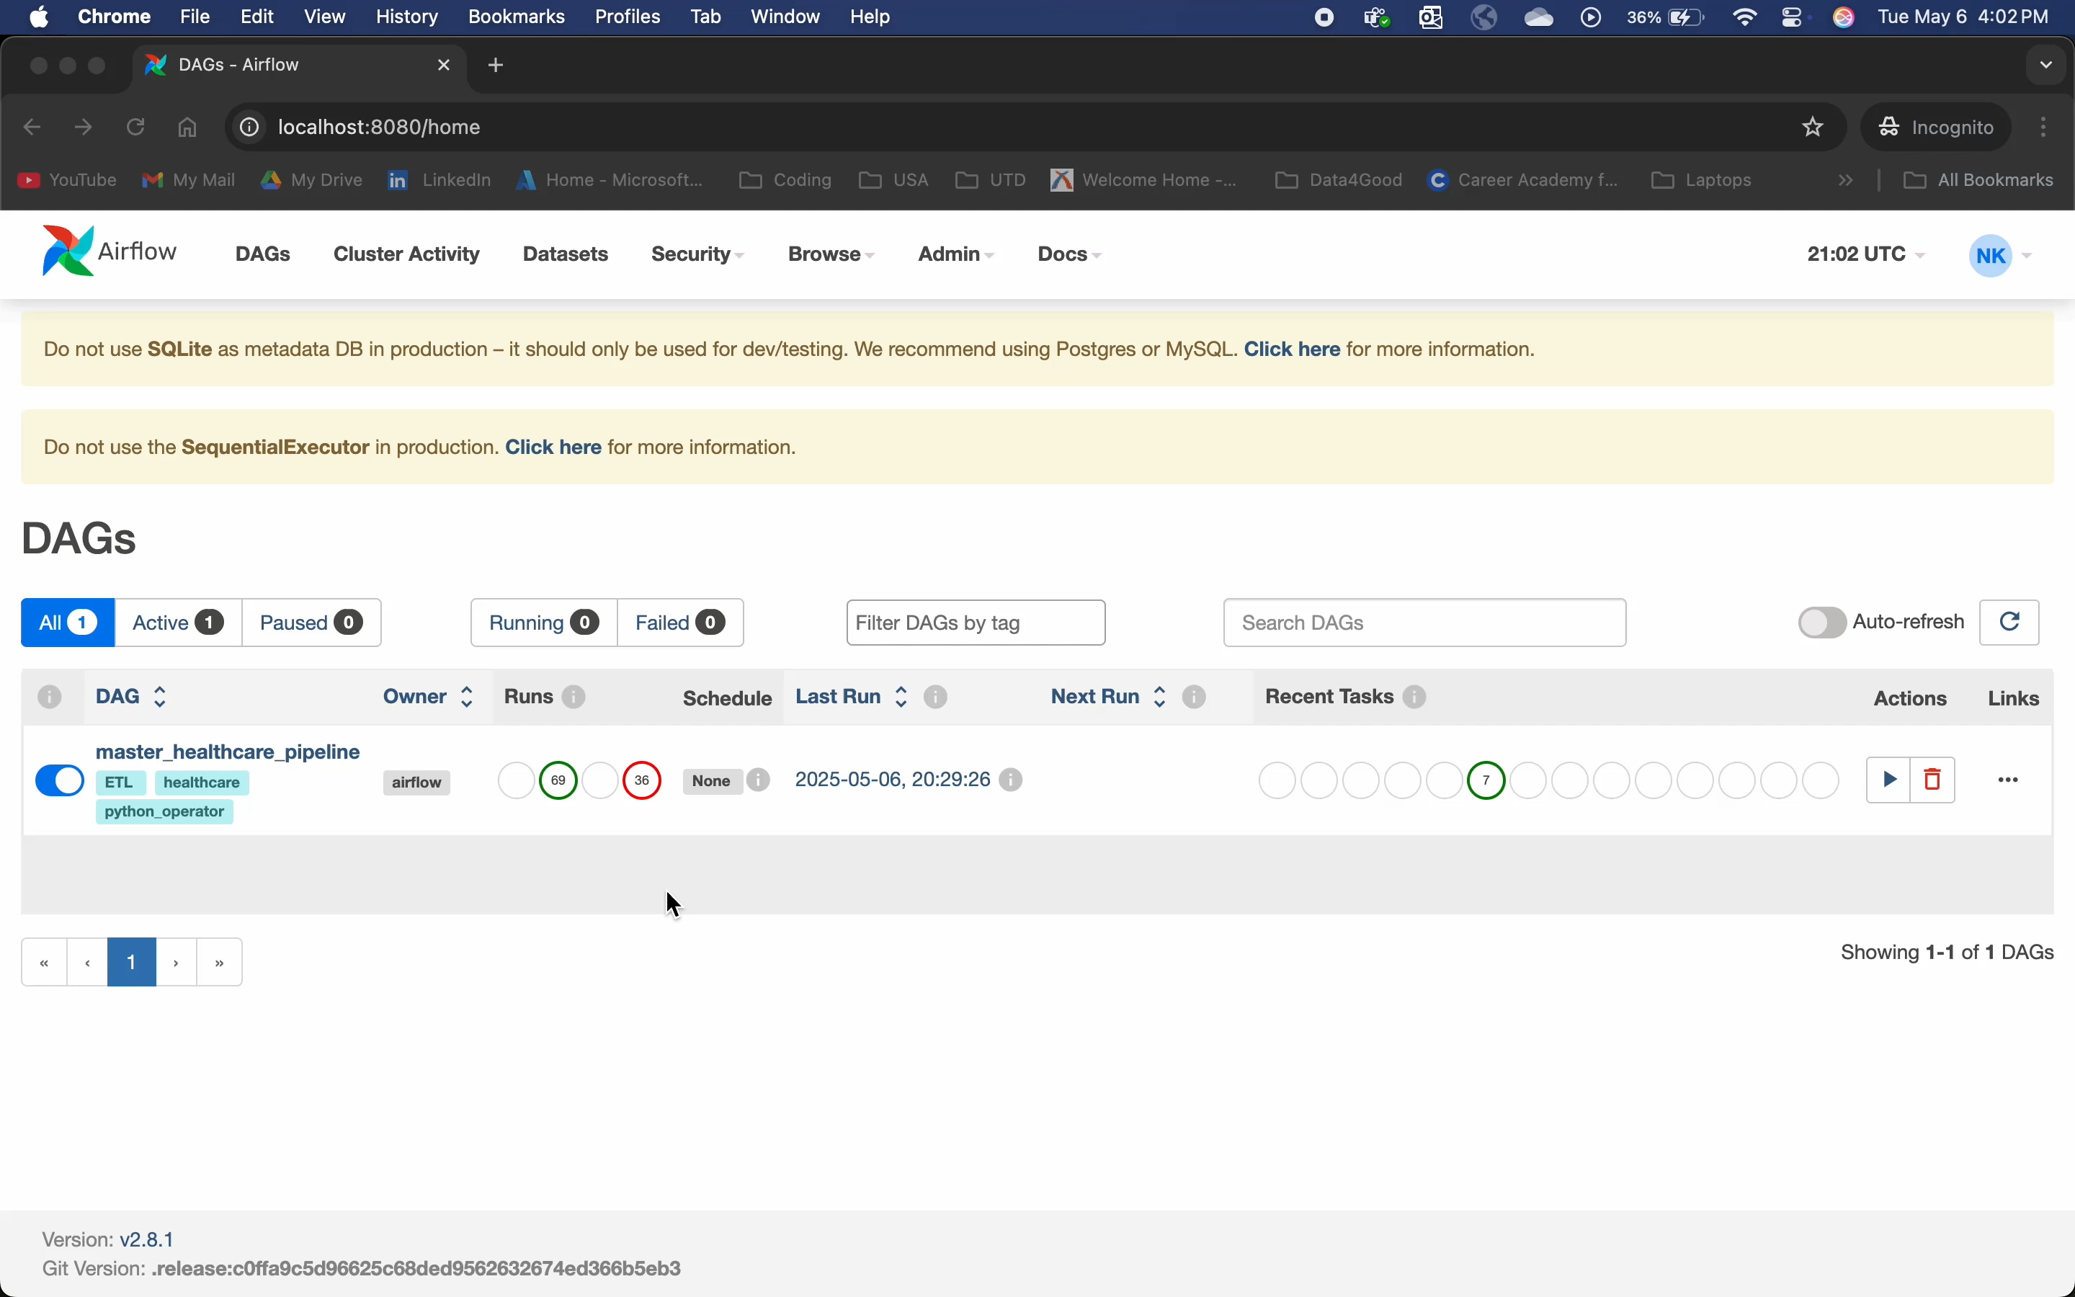

Slide 7
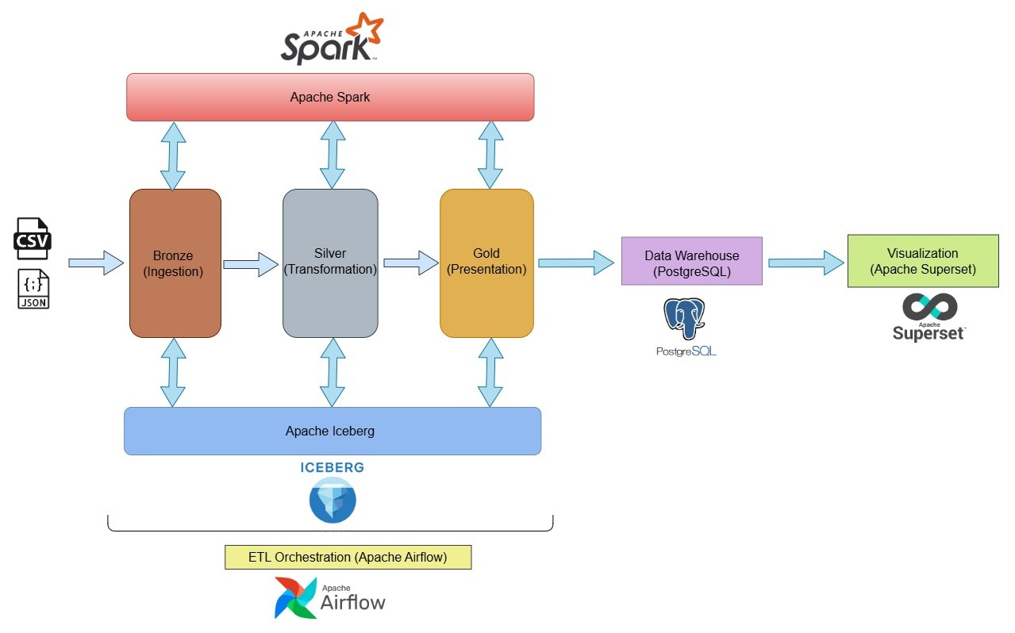

SOLUTION ARCHITECTURE:

Slide 8
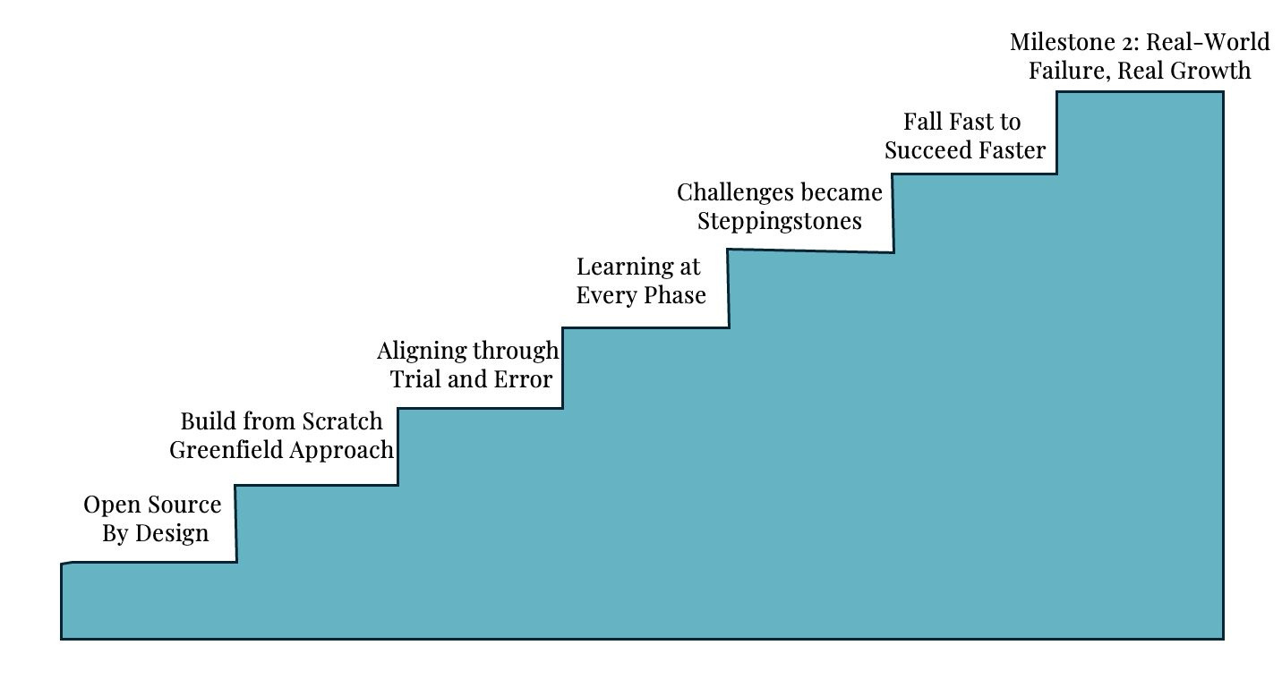
MILESTONE MOMENTS: TRACING OUR PROJECT JOURNEY

Slide 9




LOOKING AHEAD: FUTURE ENHANCEMENTS AND OPPORTUNITIES
Optimize and scale Airflow pipelines, with more refined and professional data modeling
Integrate NLP models to categorize treatments using service descriptions
Apply ML models for cost prediction and provider benchmarking (e.g., Linear Regression, Random Forest, XG Boost)

Slide 10
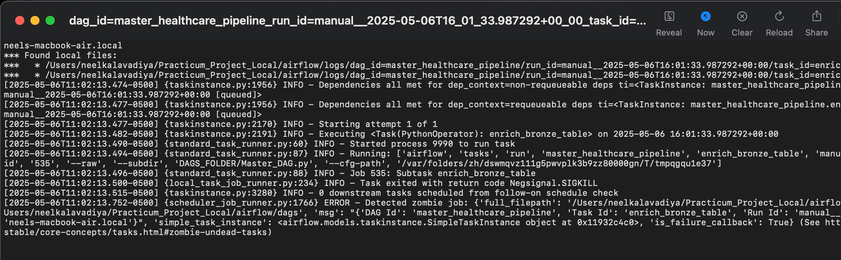
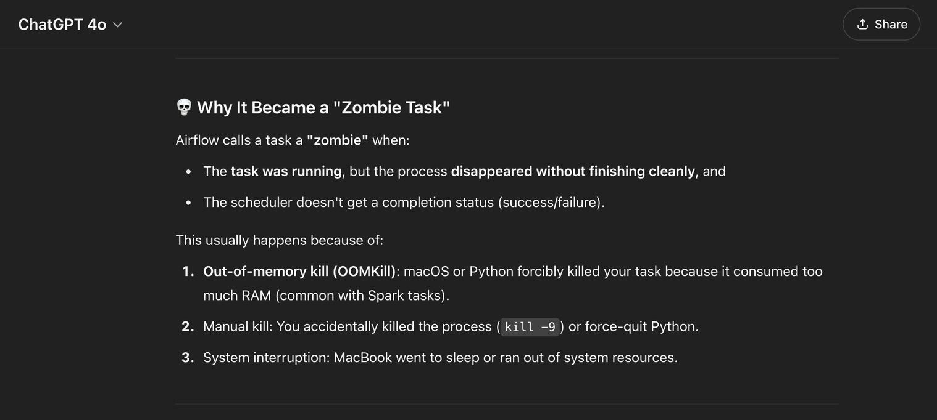

Slide 11
THANK YOU

